Slide 2

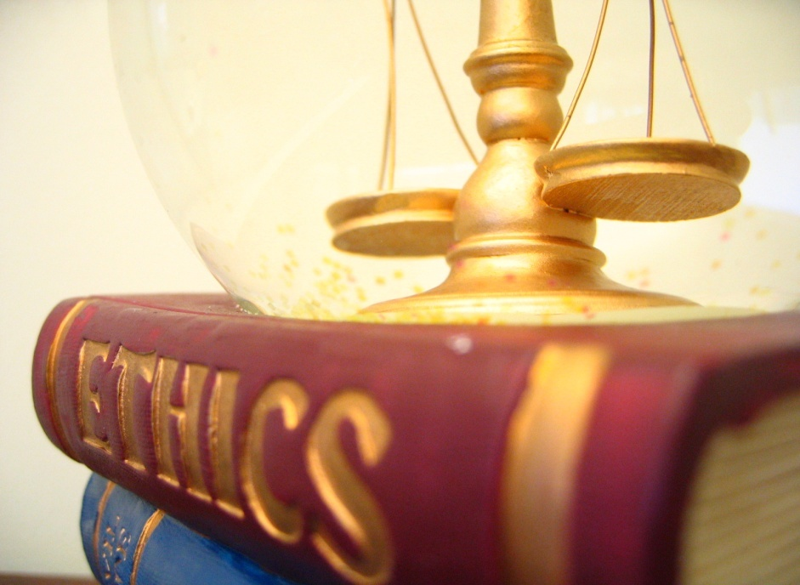
Ethics

Slide 3
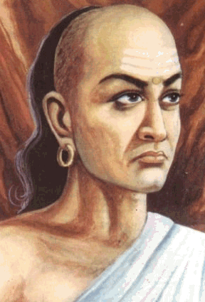
Moral excellence is an ornament for personal beauty.

Slide 4
Those base men who speak of the secret faults of others destroy themselves like serpents that stray onto anthills.

Slide 5
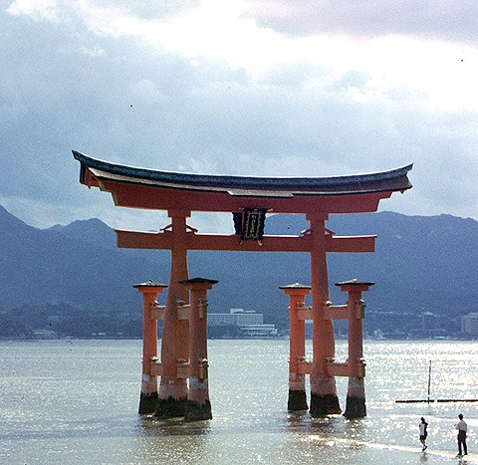
The reputation of a thousand years may be determined by the conduct of one hour.
Japanese proverb

Slide 6
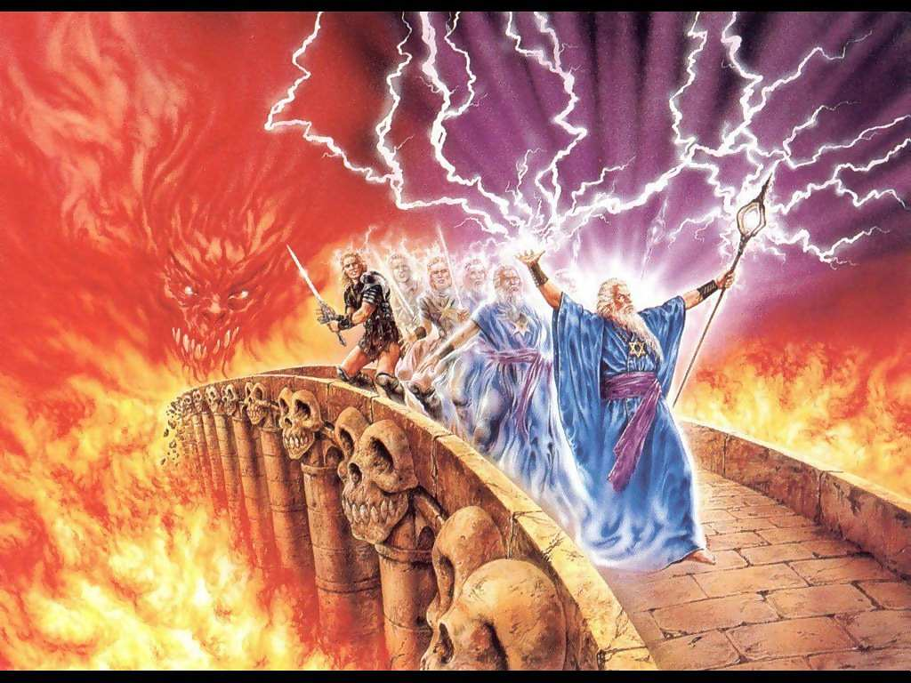
Oath of a Jewish physician
Preserve the strength of my body, mind and soul that they ever be ready to help and support rich and poor, good and bad, enemy as well as friend, for that in the sufferer, let me see the human being.

Slide 7

At the end of the class
What is ethics ?
Ethical principles .
Ethical rules prescribed by DCI .
Unethical practices .

Slide 8

Introduction
“Ethics” is derived from the Greek word ‘ethos’ meaning custom or character.
Ethics is the philosophy of human conduct, a way of stating and evaluating principles by which problems of behavior can be solved.
Its considered with ideals and values.

Slide 9
What is Ethics?
It’s a branch of philosophy concerned with the study of those concepts that are used to evaluate human activities, in particular the concepts of goodness and obligation.
Dental ethics would mean moral duties and obligations of the dentist towards his patients, professional colleagues and to the society.

Slide 10
Definition of Ethics
Is defined as
"the science of the ideal human character and behaviour in situations where distinction must be made between right and wrong, duty must be followed and good interpersonal relations maintained".

Slide 11
The Indian Scenario
‘Ethical rules for Dentists’ were initially formed by the DCI, and the Dentist Act was amended via section 17A.
The code of ethics was framed by the Dental Council in 1975 and later notified by the Government of India as Dentists Regulations 1976.
It is in force from August 1976.

Slide 12


Slide 13

Why Code of Dental Ethics ?
A systematic body of rules is needed "in order that dignity and honour of the dental profession may be upheld, its standards exalted, its sphere of usefulness extended and the advancement of dental science promoted.

Slide 14

Why Code of Dental Ethics ?
And the members of the dental association may understand the duties and obligations clearly to the dental profession, to their patients and to the community at large.

Slide 15
Profession
A profession consists of a limited group of persons who have acquired some special skill and are therefore able to perform that function in society better than the average person.
A professional person is expected to have respect for human beings, competence in his chosen field, integrity and primary concern with service rather than with prestige or profit. .

Slide 16
Dentistry as a Profession
Hippocrates is given credit for writing what could be the first voluntary code of regulations for the medical profession, protecting the right of patients and appealing to the finer instincts of the physician.
In dentistry the code of ethics is ADA’s Principles of Ethics and Code of Professional Conduct.

Slide 17

Ethical Principles
1. Non maleficent (DO NO HARM)
(Treating without sterilization)
2. Beneficence (DO BENIFIT)
(Avoid unnecessary trauma to teeth)
3. Autonomy
( Patient has full right to make decision)

Slide 18
4. Justice
( Equality in Treatment)
5.Veracity or truthfulness
6. Confidentiality
(Maintain Professional secrecy)

Slide 19
Ethical Rules for Dentists (Prescribed by the DCI)

Slide 20
Duties of the Dentist to the Public: Police and Law courts
Every dentist should be courteous sympathetic, friendly and helpful.
He should observe punctuality in fulfilling his appointments.
He should establish a well merited reputation for professional ability.

Slide 21
Duties of the Dentist to the Public: Police and Law courts
A dentist is not bound to disclose professional secrets unless called upon by the magistrate or judge to do so.
Knowledge of a patient gained in the course of examination and treatment is privileged and should not be disclosed without the consent of the patient or an order from the presiding judge in a court of law.

Slide 22
Duties of the Dentist to the Public: Police and Law courts
The welfare of the patient should be conserved to the almost of the practitioners ability.
A dentist should not permit consideration of religion, nationality, race, party politics to intervene between his duties and his patients.
Information of a personal nature, which may be learned about or directly from a patient in the course of dental practice, should be kept in utmost confidence.

Slide 23
Towards profession .
Treatment and cure of the disease depends on the skill and prompt attention showed to the patient.
The dentist has to be sober, courteous, sympathetic, helpful, modest and punctual.
He has to be morally, mentally and physically clean.
Its obligatory to enroll in societies and be updated in knowledge and skills.

Slide 24
Towards the society
The dentist has to assume leadership in the community on maters pertaining to dental health.
People should be urged to seek care without influencing choice of dentists.

Slide 25
Duties of Dentist Towards One Another
Every dentist should cherish a proper pride in his/her colleagues and should not disparage them either by act or word.
When the dentist is entrusted with the care of the patient of another, during sickness or absence, mutual arrangement should be made regarding remuneration.

Slide 26
Duties of Dentist Towards One Another
If a dentist is consulted by the patient of another dentist and the former find that the patient is suffering from previous faulty treatment, it is his duty to institute correct treatment and in such a manner as to avoid reflection on his predecessor.

Slide 27
Duties of Dentist Towards One Another
4. A dentist called upon in any emergency to treat the patient of another dentist, should when the emergency is provided for, retire in favor of regular or but shall be entitled to charge patient for his services.

Slide 28
Unethical Practices by Dentists

Slide 29
Unethical Practices by Dentists
Practice by unregistered persons employed by the dentist.
Dentists signed under his name and authority issuing any certificate, which is untrue, misleading or improper.
Use of bogus diplomas.

Slide 30
Unethical Practices by Dentists
Practice without a dental qualification
Use of Dentist’s name who is no longer practicing (can continue only for 1 year)
A dentist practicing medicine.
A dentist’s clinic termed as hospital
Dentist’s board displays a membership
Use of terms like tooth puller, Denture maker etc

Slide 31
Unethical Practices by Dentists
Commercial advertisements regarding practice, but dentists are allowed to advertise when they need some staff.
It should be in normal type and should state only the nature of vacancy
To sell physicians samples in clinic at a profit

Slide 32
Unethical Practices by Dentists
Not informing patients regarding change of ownership, change of address.
Dentists advertising whether directly or indirectly for the purpose of obtaining patients or promoting his own professional advantage.
Dentists name in dental health education pamphlet which is distributed to public.

Slide 33
Unethical Practices by Dentists
If a dentist whishes to announce in newspaper, the announcement should not contain his professional degree, his address and announcement should not appear in more than 3 issues of the publication

Slide 34
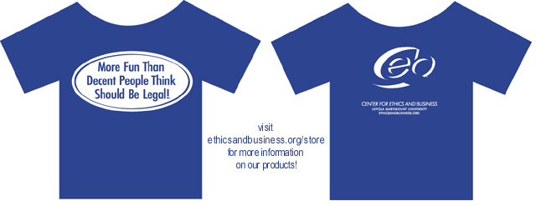
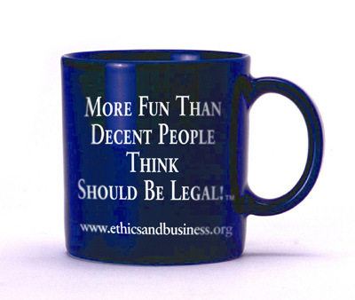
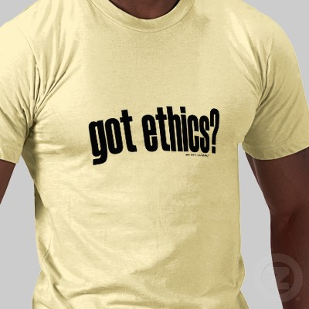

Slide 35
To summarize
Ethical principles
Prescribed by DCI
Unethical principles

Slide 36
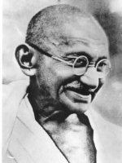
“You must be the change you wish to see in the world.”

Slide 37
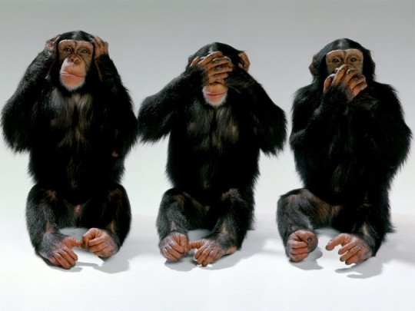
Thank you

